Slide 1

Data Modeling Using the Entity-Relationship (ER) Model
Copyright © 2004 Pearson Education, Inc.

Slide 2
Overview of Database Design Process
Two main activities:
  Database design
  Applications design
Focus in this chapter on database design
  To design the conceptual schema for a database application
Applications design focuses on the programs and interfaces that access the database
  Generally considered part of software engineering
Slide 3- <number>

Slide 3

Database Design Phases

Slide 4
Chapter Outline
Example Database Application (COMPANY)
ER Model Concepts
  Entities and Attributes
  Entity Types, Value Sets, and Key Attributes
  Relationships and Relationship Types
  Weak Entity Types
  Roles and Attributes in Relationship Types
ER Diagrams - Notation
ER Diagram for COMPANY Schema
Chapter 3-<number>

Slide 5
Example COMPANY Database
Requirements of the Company (oversimplified for illustrative purposes)
  The company is organized into DEPARTMENTs. Each department has a name, number and an employee who manages the department. We keep track of the start date of the department manager.
  Each department controls a number of PROJECTs. Each project has a name, number and is located at a single location.
Chapter 3-<number>

Slide 6
Example COMPANY Database (Cont.)
  We store each EMPLOYEE’s social security number, address, salary, sex, and birthdate. Each employee works for one department but may work on several projects. We keep track of the number of hours per week that an employee currently works on each project. We also keep track of the direct supervisor of each employee.
  Each employee may have a number of DEPENDENTs. For each dependent, we keep track of their name, sex, birthdate, and relationship to employee.
Chapter 3-<number>

Slide 7
ER Model Concepts
Entities and Attributes
  Entities are specific objects or things in the mini-world that are represented in the database. For example the EMPLOYEE John Smith, the Research DEPARTMENT, the ProductX PROJECT
  Attributes are properties used to describe an entity. For example an EMPLOYEE entity may have a Name, SSN, Address, Sex, BirthDate
  A specific entity will have a value for each of its attributes. For example a specific employee entity may have Name='John Smith', SSN='123456789', Address ='731, Fondren, Houston, TX', Sex='M', BirthDate='09-JAN-55‘
  Each attribute has a value set (or data type) associated with it – e.g. integer, string, subrange, enumerated type, …
Chapter 3-<number>

Slide 8
Types of Attributes (1)
Simple
  Each entity has a single atomic value for the attribute. For example, SSN or Sex.
Composite
  The attribute may be composed of several components. For example, Address (Apt#, House#, Street, City, State, ZipCode, Country) or Name (FirstName, MiddleName, LastName). Composition may form a hierarchy where some components are themselves composite.
Multi-valued
  An entity may have multiple values for that attribute. For example, Color of a CAR or PreviousDegrees of a STUDENT. Denoted as {Color} or {PreviousDegrees}.
Chapter 3-<number>

Slide 9

Types of Attributes (2)
In general, composite and multi-valued attributes may be nested arbitrarily to any number of levels although this is rare. For example, PreviousDegrees of a STUDENT is a composite multi-valued attribute denoted by {PreviousDegrees (College, Year, Degree, Field)}.
Single-Valued versus Multivalued Attributes
Stored versus Derived Attributes.
NULL Values.
Complex Attributes
Chapter 3-<number>

Slide 10
Entity Types and Key Attributes
Entities with the same basic attributes are grouped or typed into an entity type. For example, the EMPLOYEE entity type or the PROJECT entity type.
An attribute of an entity type for which each entity must have a unique value is called a key attribute of the entity type. For example, SSN of EMPLOYEE.
A key attribute may be composite. For example, VehicleTagNumber is a key of the CAR entity type with components (Number, State).
An entity type may have more than one key. For example, the CAR entity type may have two keys:
  VehicleIdentificationNumber (popularly called VIN) and
  VehicleTagNumber (Number, State), also known as license_plate number.
Chapter 3-<number>

Slide 11
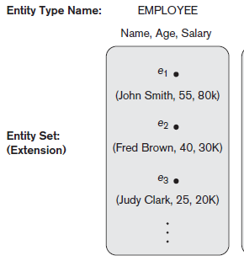
Chapter 3-<number>

Slide 12
ENTITY SET corresponding to the
ENTITY TYPE CAR
CAR
Registration(RegistrationNumber, State), VehicleID, Make, Model, Year, (Color)
car₁
((ABC 123, TEXAS), TK629, Ford Mustang, convertible, 1999, (red, black))
car₂
((ABC 123, NEW YORK), WP9872, Nissan 300ZX, 2-door, 2002, (blue))
car₃
((VSY 720, TEXAS), TD729, Buick LeSabre, 4-door, 2003, (white, blue))
.
.
.
Chapter 3-<number>

Slide 13
SUMMARY OF ER-DIAGRAM
NOTATION FOR ER SCHEMAS
Symbol
Meaning
ENTITY TYPE
WEAK ENTITY TYPE
RELATIONSHIP TYPE
IDENTIFYING RELATIONSHIP TYPE
ATTRIBUTE
KEY ATTRIBUTE
MULTIVALUED ATTRIBUTE
COMPOSITE ATTRIBUTE
DERIVED ATTRIBUTE
TOTAL PARTICIPATION OF E₂ IN R
CARDINALITY RATIO 1:N FOR E₁:E₂ IN R
STRUCTURAL CONSTRAINT (min, max) ON PARTICIPATION OF E IN R
E₁
R
E₂
E₁
R
N
E₂
R
(min,max)
E
Chapter 3-<number>

Slide 14

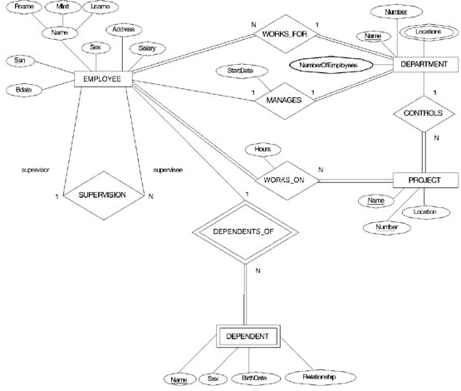
ER DIAGRAM – Entity Types are:
EMPLOYEE, DEPARTMENT, PROJECT, DEPENDENT
Chapter 3-<number>

Slide 15
Relationships
Chapter 3-<number>

Slide 16
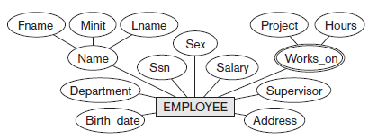
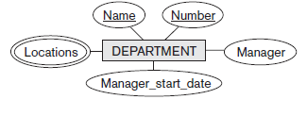
Chapter 3-<number>

Slide 17
Relationships and Relationship Types (1)
A relationship relates two or more distinct entities with a specific meaning. For example, EMPLOYEE John Smith works on the ProductX PROJECT or EMPLOYEE Franklin Wong manages the Research DEPARTMENT.
Relationships of the same type are grouped or typed into a relationship type. For example, the WORKS_ON relationship type in which EMPLOYEEs and PROJECTs participate, or the MANAGES relationship type in which EMPLOYEEs and DEPARTMENTs participate.
The degree of a relationship type is the number of participating entity types. Both MANAGES and WORKS_ON are binary relationships.
Chapter 3-<number>

Slide 18
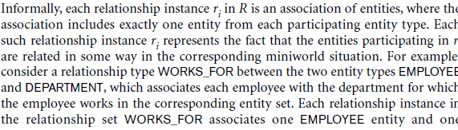
Chapter 3-<number>

Slide 19
ER DIAGRAM – Entity Types are:
EMPLOYEE, DEPARTMENT, PROJECT, DEPENDENT
Chapter 3-<number>

Slide 20
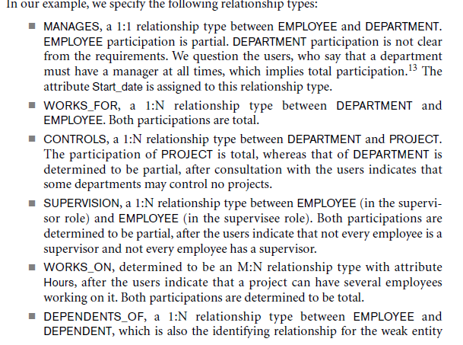
Chapter 3-<number>

Slide 21
Example relationship instances of the WORKS_FOR relationship between EMPLOYEE and DEPARTMENT
EMPLOYEE
WORKS_FOR
DEPARTMENT
e_{1 }
e_{2 }
e_{3 }
e_{4 }
e_{5 }
e_{6 }
e_{7 }
r₁
r₂
r₃
r₄
r₅
r₆
r₇
● d₁
● d₂
● d₃
Chapter 3-<number>

Slide 22
Example relationship instances of the WORKS_ON relationship between EMPLOYEE and PROJECT
e_{1 }
e_{2 }
e_{3 }
e_{4 }
e_{5 }
e_{6 }
e_{7 }
r₉
r₁
r₂
r₃
r₄
r₅
r₆
r₇
● p₁
● p₂
● p₃
r₈
Chapter 3-<number>

Slide 23
Weak Entity Types
An entity that does not have a key attribute
A weak entity must participate in an identifying relationship type with an owner or identifying entity type
Entities are identified by the combination of:
  A partial key of the weak entity type
  The particular entity they are related to in the identifying entity type
Example:
Suppose that a DEPENDENT entity is identified by the dependent’s first name and birhtdate, and the specific EMPLOYEE that the dependent is related to. DEPENDENT is a weak entity type with EMPLOYEE as its identifying entity type via the identifying relationship type DEPENDENT_OF
Chapter 3-<number>

Slide 24

Weak Entity Type is: DEPENDENT
Identifying Relationship is: DEPENDENTS_OF
Chapter 3-<number>

Slide 25

Entitiy type, relationship type –caps
Entity type, relationship type –caps
Attribute name- initial caps
Entity –singular names nouns
Attribute- noun
Relationship- verbs- left to right- top to bottom
DEPENDENTS_OF -> HAS _DEPENDENTS
Do refinement.
Chapter 3-<number>

Slide 26
Acadia Teaching Database
Design an E-R schema for a database to store info about professors, courses and course sections indicating the following:
The name and employee ID number of each professor
The salary and email address(es) for each professor
How long each professor has been at the university
The course sections each professor teaches
The name, number and topic for each course offered
The section and room number for each course section
Each course section must have only one professor
Each course can have multiple sections

